Slide 1
APLIKASI DIODA
Kuliah tgl 8 Maret 2021
ELKA B

Slide 2
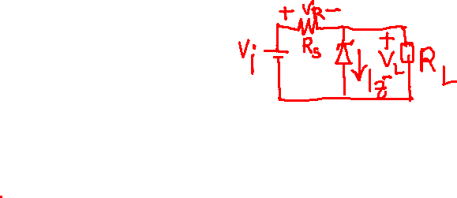
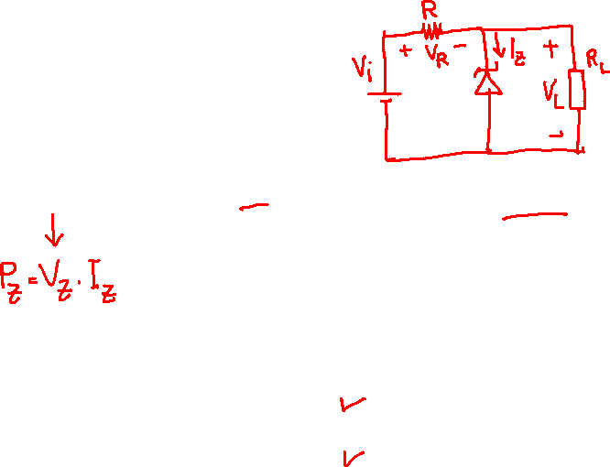
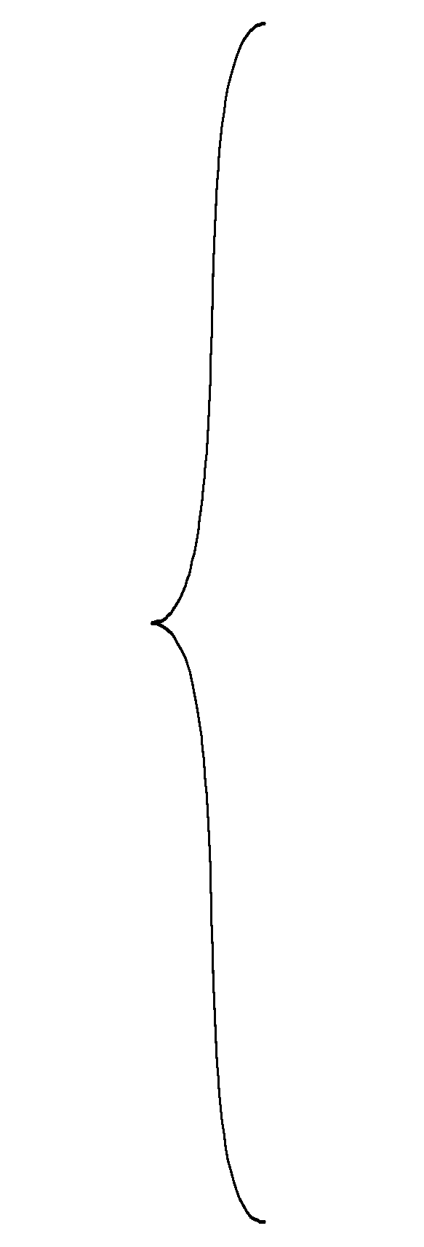
Contoh Soal:
V_{i} = 16 Volt
Tentukan V_{L}, V_{R}, I_{Z} dan P_{Z} bila V_{Z} = 10 Volt dan P_{ZM} = 30 mW
R = 1 KΩ
Untuk a) R_{L} = 1.2 kΩ
b) R_{L} = 3 kΩ

Slide 3
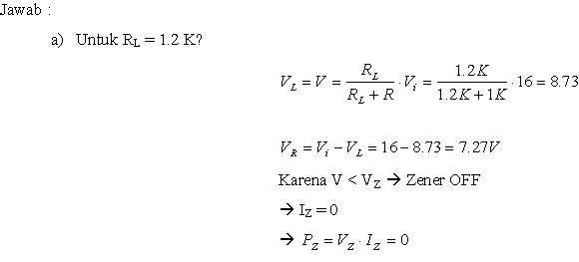


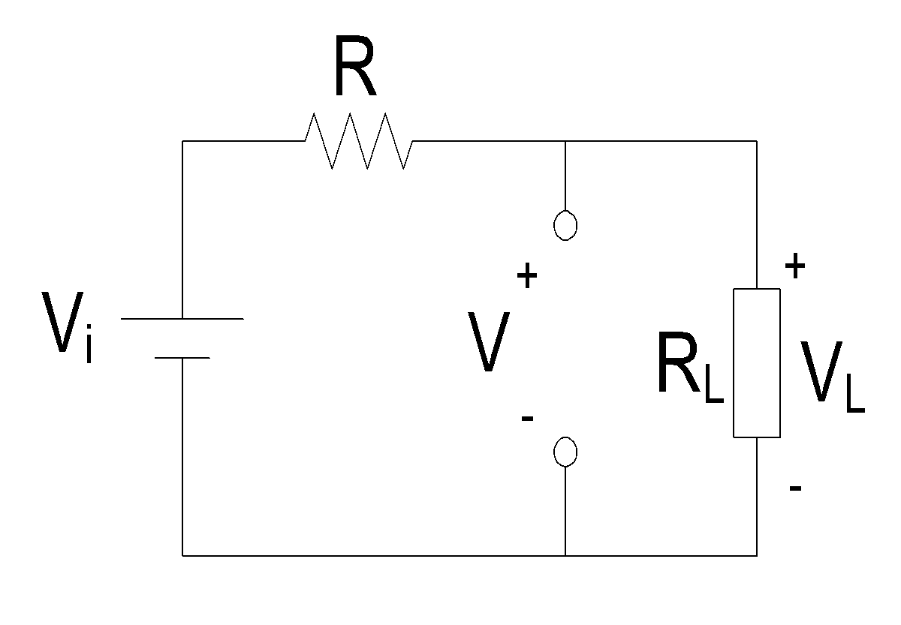


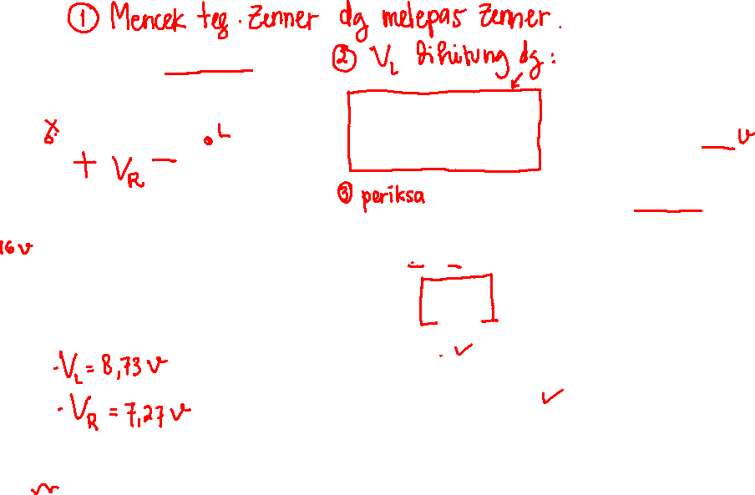

Slide 4
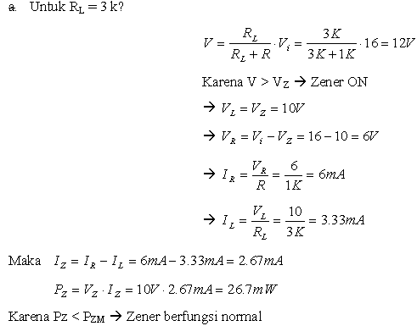




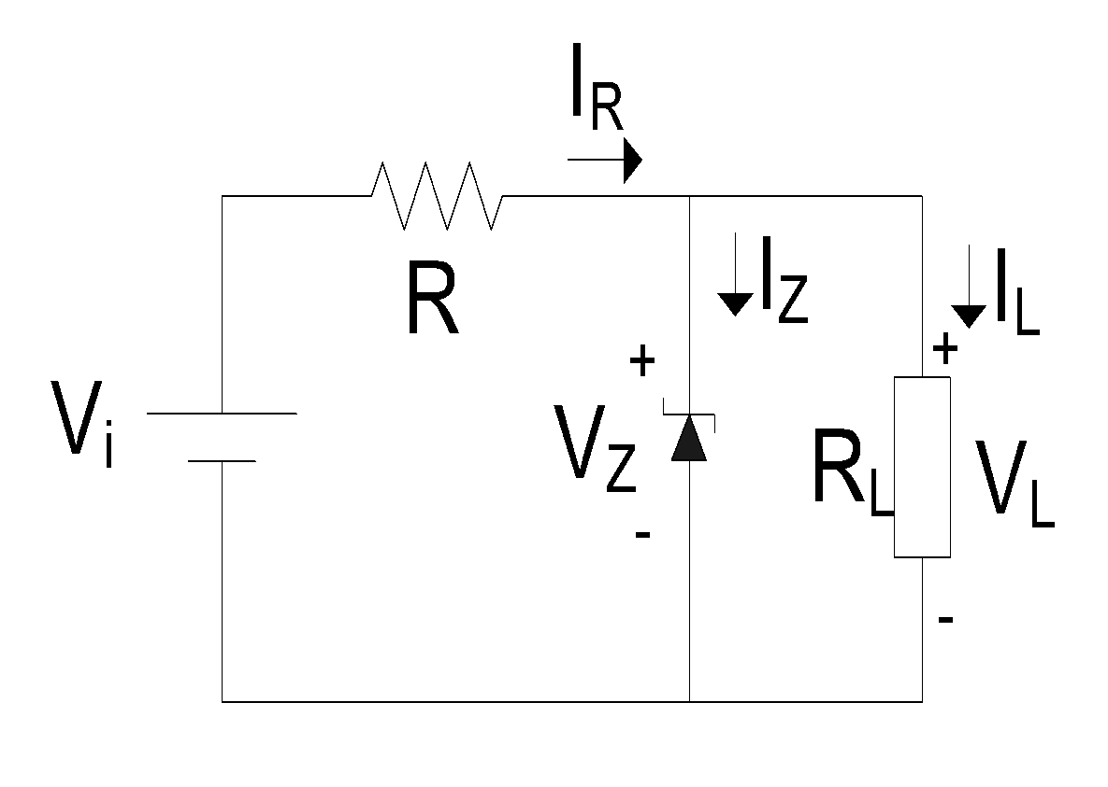


Slide 5

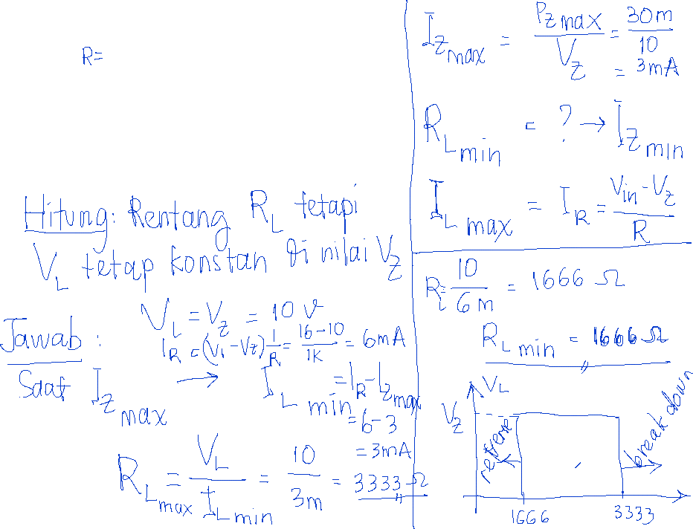
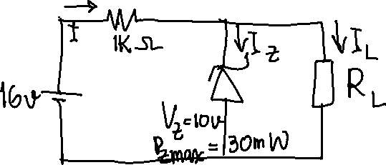

Slide 6



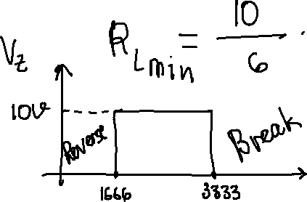
























Slide 7


















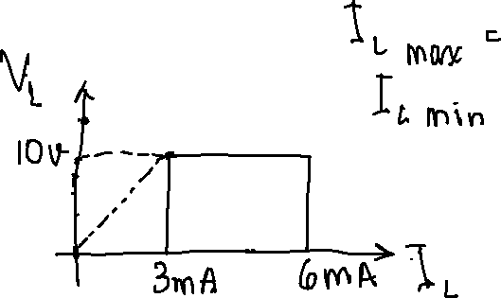

Slide 9







Slide 10
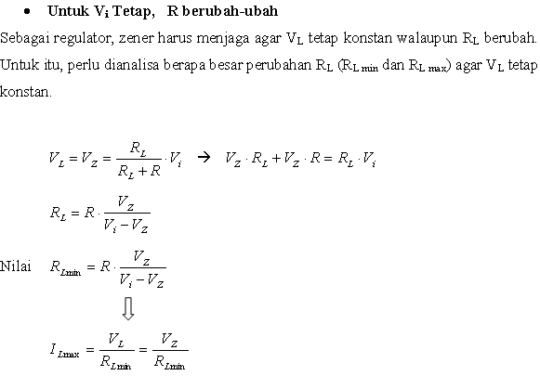

Slide 11
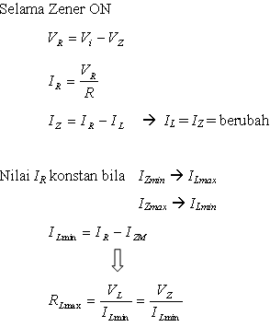

Slide 12
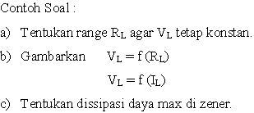
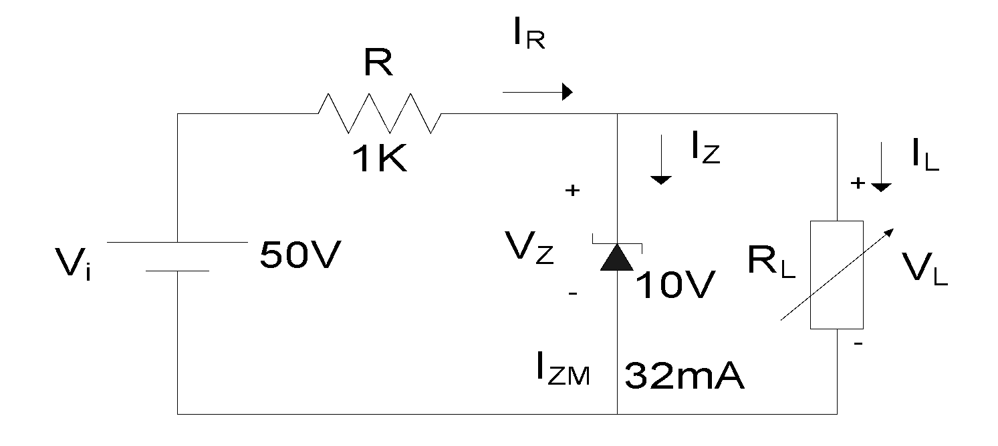

Slide 13
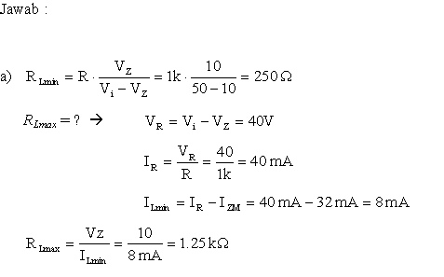
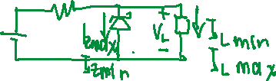

Slide 14
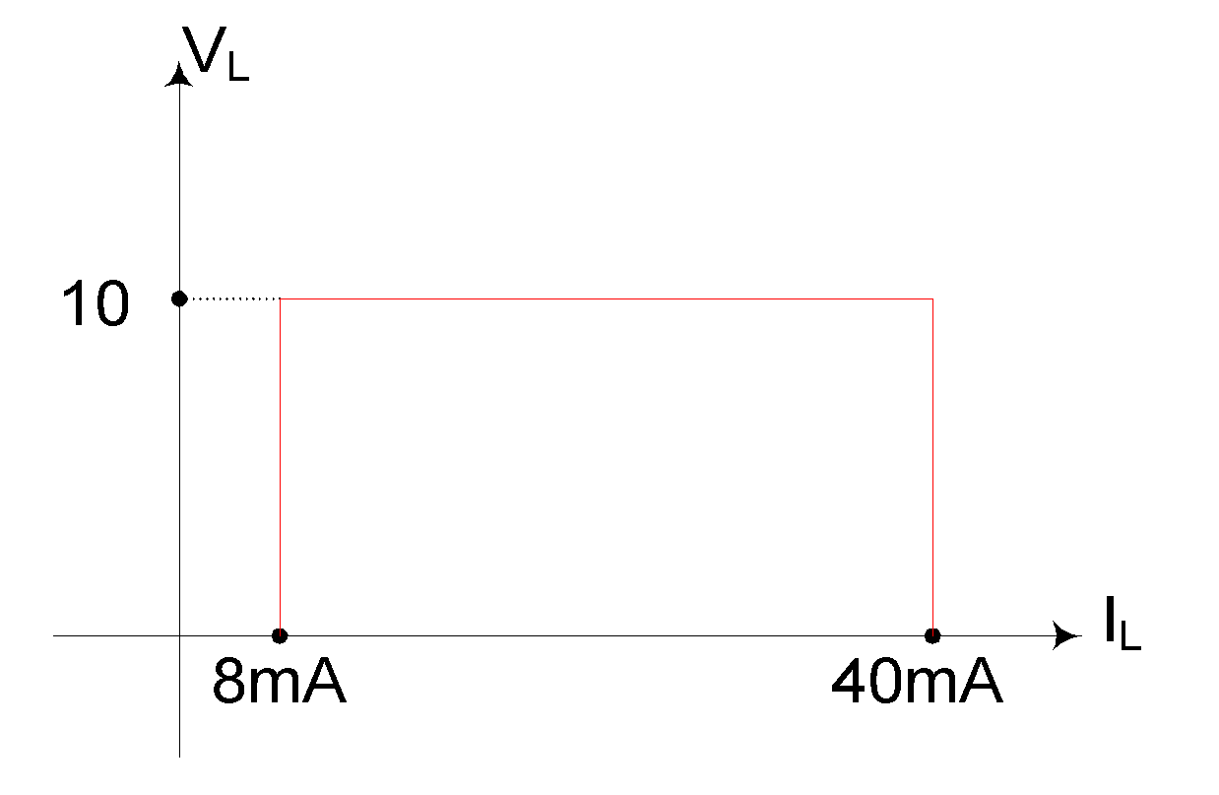
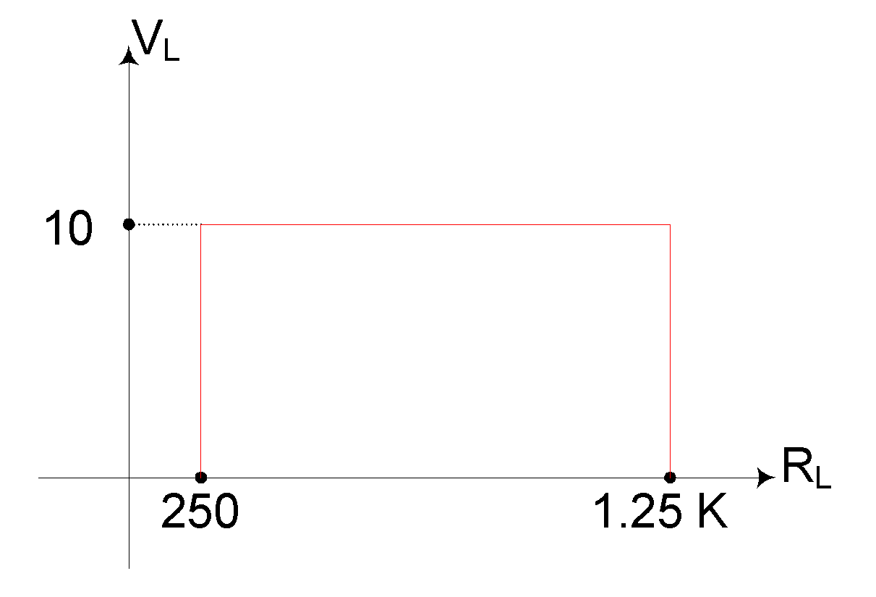
b)
c)

Slide 15
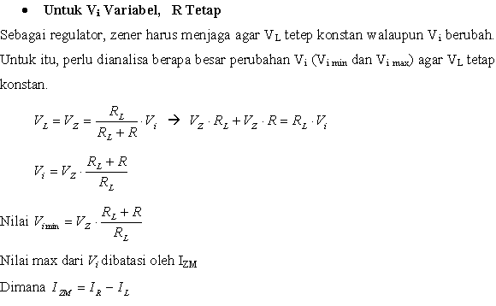

Slide 16
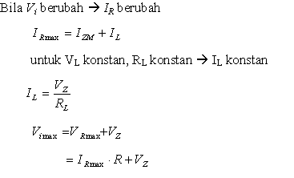

Slide 17

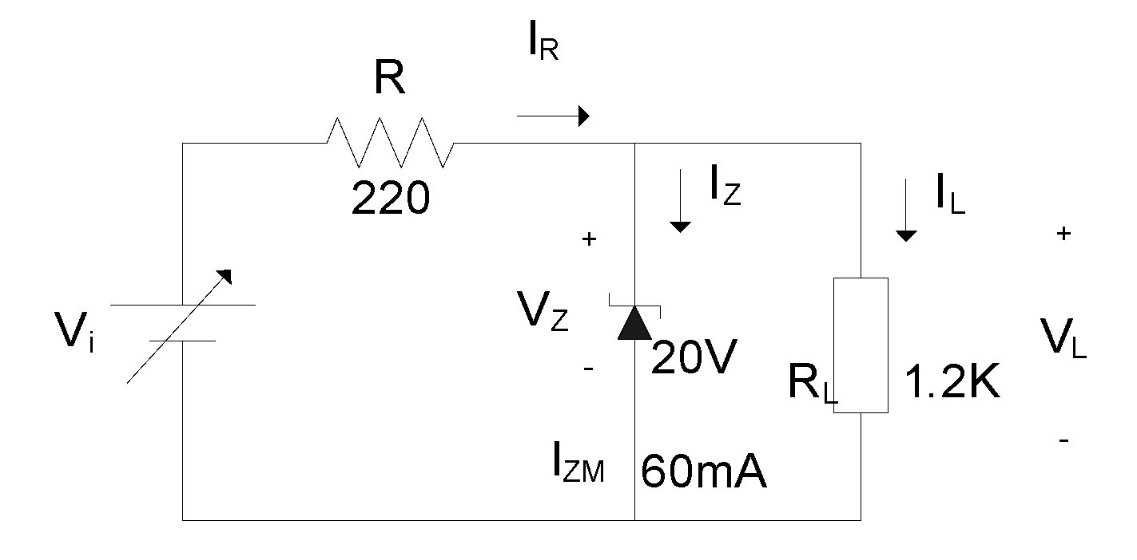
Contoh Soal :

Slide 18
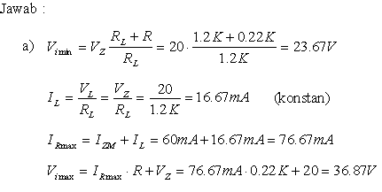

Slide 19
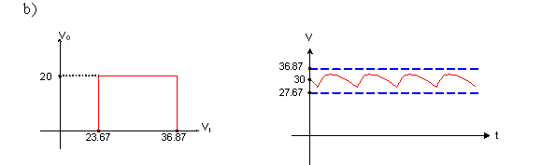

Slide 20
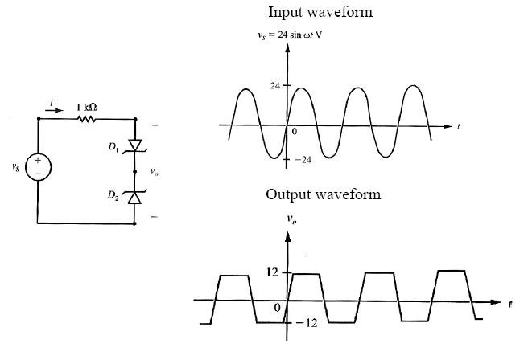



Zener sebagai Clipper

Slide 21
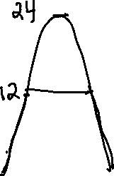
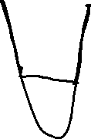







Slide 22
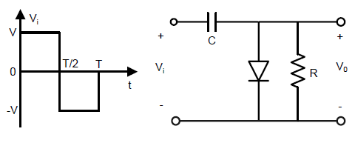
CLAMPER

Slide 23
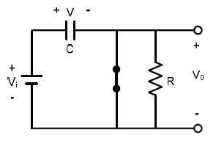

Selama interval 0 – T/2 rangkaian dapat digambarkan sebagai berikut
Dioda ON dan kapasitor akan mengisi sampai V volt

Slide 24
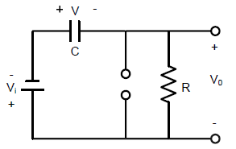



Ketika polaritas input terbalik, rangkaian dapat digambarkan sebagai berikut.
Menetapkan Output Pada Saat Dioda OFF

Slide 25
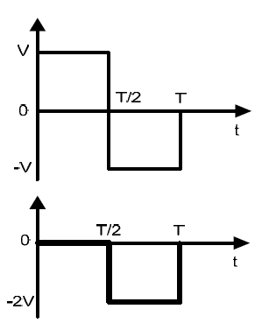

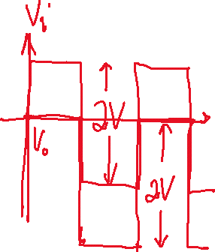


Input/Output dari Contoh Rangkaian Clamper

Slide 26
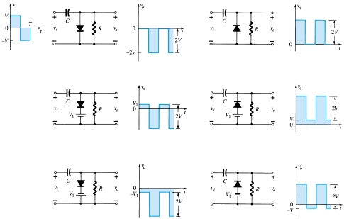

Slide 27
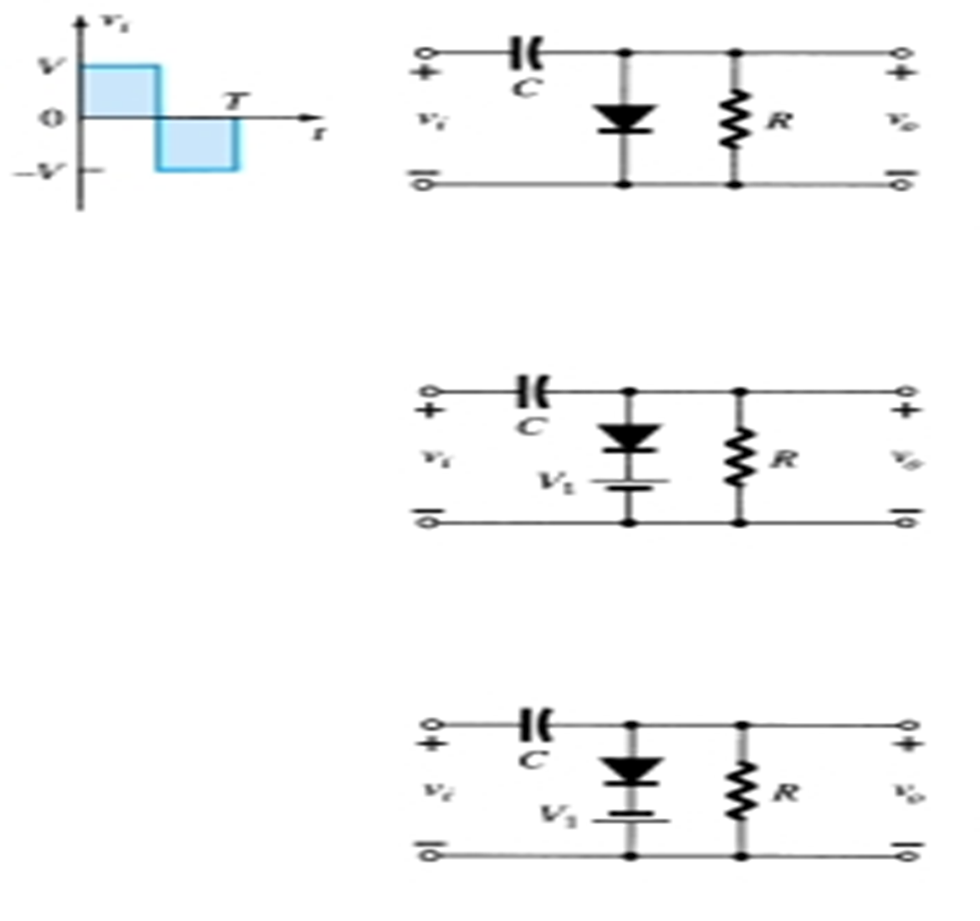
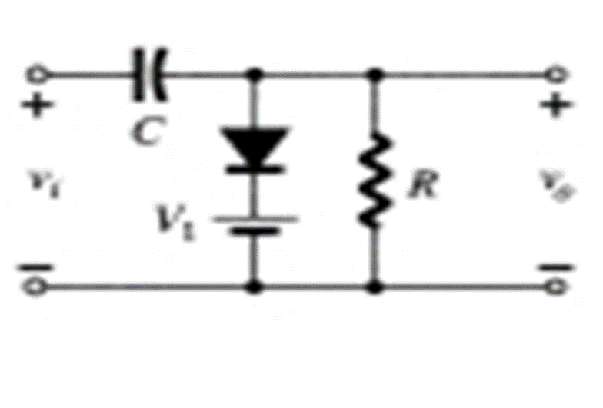


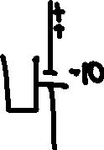
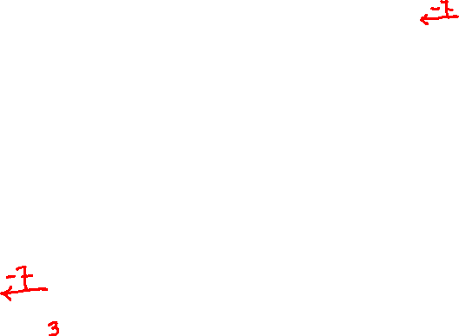

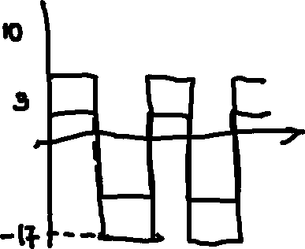







Slide 29
Berbagai variasi dari rangkaian clamper
Rangkaian Clamper dengan Dioda Ideal

Slide 30
Rangkaian Pengali Tegangan
Rangkaian ini digunakan untuk menaikan tegangan puncak dari trafo hingga 2x, 3x, atau lebih besar.

Slide 31
Voltage Doubler
Voltage doublers allow you to develop higher voltages without a transformer.
Stages can be cascaded to produce triplers, quadruplers, etc.
Voltage multipliers usually supply low currents to a high-resistance load.
Output voltage usually drops quickly as load current increases.

Slide 32
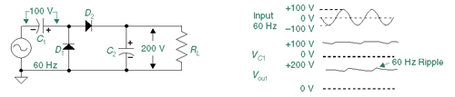
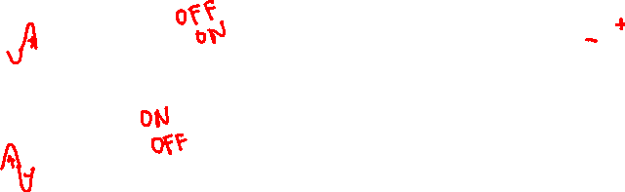
Voltage Doubler
On negative half-cycle, D1 charges C1 to Vp.
On positive half-cycle D2 adds AC peak to Vp on C1
and transfers it all to C2.

Slide 33
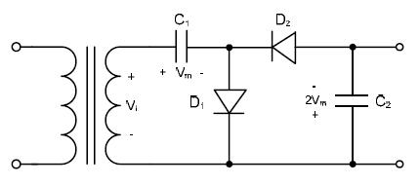
Half Wave Voltage Doubler
Tegangan pada output :
- V_{C2} + V_{C1} + Vm = 0
- V_{C2} + Vm + Vm = 0
V_{C2} = 2Vm

Slide 34
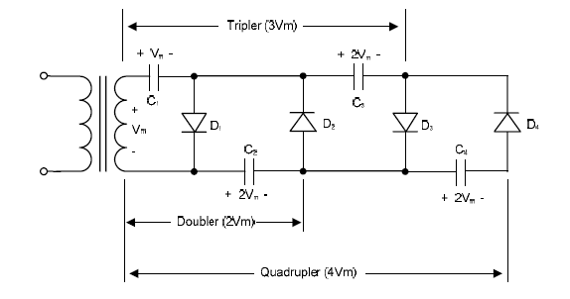
Rangkaian Pengali 3 dan Pengali 4 tegangan

Slide 35
The Q Point
The operating point or Q point of the diode is the quiescent or no-signal condition. The Q point is obtained graphically and is really only needed when the applied voltage is very close to the diode’s barrier potential voltage. The example ³ below that is continued on the next slide, shows how the Q point is determined using the transconductance curve and the load line.
First the load line is found by substituting in different values of V_{φ} into the equation for I_{D} using the ideal diode with barrier potential model for the diode. With R_{S} at 1000 ohms the value of R_{F} wouldn’t have much impact on the results.
I_{D} = V_{A} – V _{φ}
R_{S}
Using V _{φ} values of 0 volts and 1.4 volts we obtain I_{D} values of 6 mA and 4.6 mA respectively. Next we will draw the line connecting these two points on the graph with the transconductance curve. This line is the load line.
R_{S} = 1000 Ω
I_{D}
+
V_{A}
= 6V
_
+
V_{φ}

Slide 36
The Q Point
The transconductance curve below is for a Silicon diode. The Q point in this example is located at 0.7 V and 5.3 mA.
I_{D} (mA)
12
10
8
Q Point: The intersection of the load line and the transconductance curve.
6
5.3
4.6
4
2
V_{D} (Volts)
0.2
0.4
0.6
0.8
1.0
1.2
1.4
0.7

Slide 37
Dynamic Resistance
Example: Use the same circuit used for the Q point example but change the voltage source so it is an ac source with a dc offset. The source voltage is now, v_{in} = 6 + sin(wt) Volts. It is a silicon diode so the barrier potential voltage is still 0.7 volts.
R_{S} = 1000 Ω
The DC component of the circuit is the same as the previous example and therefore I_{D} = 6V – 0.7 V = 5.2 mA
1000 
r_{F} = ηV_{T} = 1 * 26 mV = 4.9 
I_{D} 5.3 mA
η = 1 is a good approximation if the dc current is greater than 1 mA as it is in this example.
I_{D}
+
v_{in}
+
V_{φ}
v_{F} = v_{ac} r_{F} = sin(wt) V 4.9  = 4.88 sin(wt) mV
r_{F} + R_{S} 4.9  + 1000 
Therefore, V_{D} = 700 + 4.9 sin (wt) mV (the voltage drop across the diode)

Slide 38
